Slide 1
Police Investigation Summary
Investigator: Inspector Hamza Malik
Incident Date: 10 July 2025
Location: Mall Road Lahore

Slide 2
Evidence | Status
CCTV | Collected
Witness Statements | Completed
Phone Records | Pending
DNA Report | Pending

Slide 3
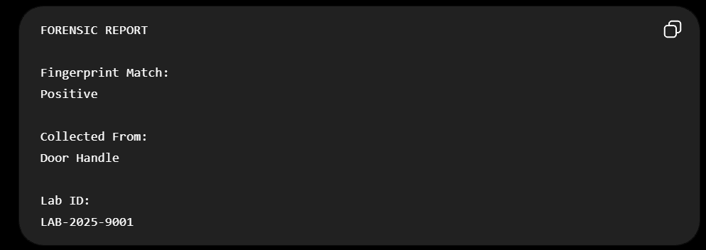
Notes:
Witness A changed testimony.
Verify CCTV timestamp.
Interview security guard again.

